Slide 1
Careseeker’s Blockchain
Avinash Kumar Gupta
MBBS - 3rd Year

Slide 2

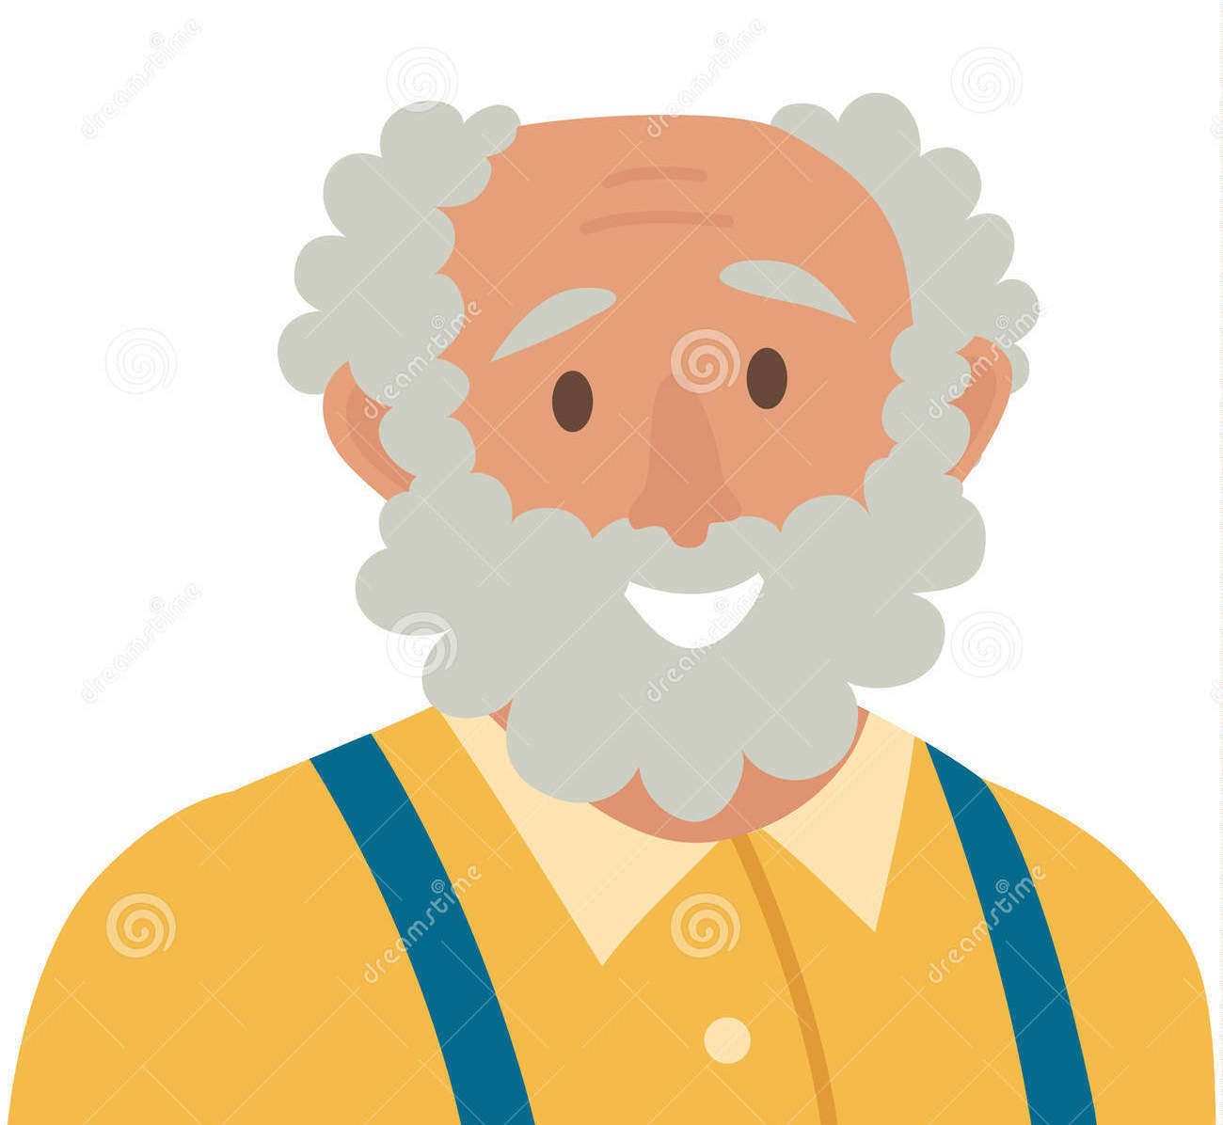
Wearables
Health Data
1 individual from Doctors, Students, nurses, or any medico from a care taking team.
Specialis
Doctor
Student
Nurse
Laboratory
Pharmacy
Medical Advice
EMRs
Health Data

Slide 3
Example Transactions ( Smart Contracts)
A medical student studies the case and solve questions in PICO format by finding evidences from books and research articles
A device tracks exercise and logs it along with vitals
1
3
2
A doctor explore the data and advice an exercise
4
A patient real-time data accessed by AI and emergency calls in case of any mishap.

Slide 4

Thank you.

